Slide 1

Chapter 3: The Project Management Process Groups: A Case Study
Information Technology Project Management, Seventh Edition
Note: See the text itself for full citations.

Slide 2
Learning Objectives
Describe the five project management process groups, the typical level of activity for each, and the interactions among them
Understand how the project management process groups relate to the project management knowledge areas
Describe several templates for creating documents for each process group
Information Technology Project Management, Sixth Edition

Slide 3
Project Management Process Groups
A process is a series of actions directed toward a particular result
Project management can be viewed as a number of interlinked processes
The project management process groups include
initiating processes
planning processes
executing processes
monitoring and controlling processes
closing processes

Slide 4
Mapping the Process Groups to the Knowledge Areas
You can map the main activities of each PM process group into the ten knowledge areas using the PMBOK® Guide, Fifth Edition, 2012
Note that there are activities from each knowledge area under the planning process groups

Slide 5
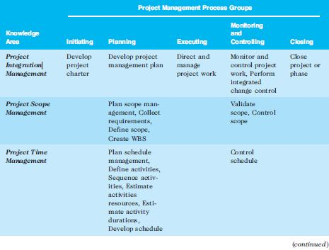
Table 3-1. Project Management Process Groups and Knowledge Area Mapping*
*Source: PMBOK® Guide, Fifth Edition, 2012.

Slide 6
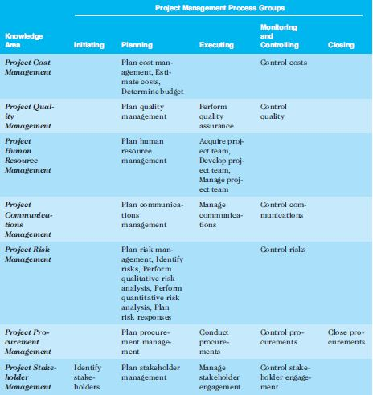
Table 3-1. continued

Slide 7
Developing an IT Project Management Methodology
Just as projects are unique, so are approaches to project management
Many organizations develop their own project management methodologies, especially for IT projects
A methodology describes how things should be done; a standard describes what should be done
PRINCE2, Agile, RUP, and Six Sigma provide different project management methodologies

Slide 8
Project Pre-initiation
It is good practice to lay the groundwork for a project before it officially starts
Senior managers often perform several pre-initiation tasks, including the following:
Determine the scope, time, and cost constraints for the project
Identify the project sponsor
Select the project manager
Develop a business case for a project (see Table 3-2 for an example)
Meet with the project manager to review the process and expectations for managing the project
Determine if the project should be divided into two or more smaller projects

Slide 9
Business Case : Template [key Elements]
Introduction/Background
Provide brief background information on the organization so that a reader can easily relate to why the organization wants to undertake this project. One paragraph (3 or 4 sentences)
Business Objectives
Link the project to strategic (or long term) goals/objectives of the business organization. One paragraph (4 to 5 sentences)
Current Situation and problem/opportunity
A brief description of current business situation
Identify the business issues that could be solved through the IT project or identify the business opportunities that exist which could be achieved effectively through the IT Project. One paragraph (4 to 5 sentences)
Critical Assumptions and Constraints
Clearly state the strategic nature of the unique product (project output).
Argue for its support from the key stakeholders.
Mention about the expected payback period.
What will be the impact on business (operating cost and revenue)
Assumption about the hardware and software need for this product
Accessibility/security. One paragraph (6 to 7 sentences)

Slide 10
Business Case : Template [key Elements]
Analysis of Options and Recommendation
list all the options to solve or take the business opportunity.
Identify the best option
Preliminary Project Requirements
List and briefly explain all the key requirements
Budget Estimate and Financial Analysis
Identify and briefly explain your preliminary budget
Identify and explain your expected yearly benefit, NPV, ROI and payback year
Half page two or three paragraphs. Refer to the handout
Schedule Estimate
State the expect time-frame and any other assumptions in relation to the project schedule
State the product life.
Potential Risks
Identify and briefly talk about potential risks
Exhibits
Provide an exhibit to support your claims (budget estimate and financial analysis).

Slide 12
Calculations
Discount factor (rate) =
1/(1 + r)^{t}
r = discount rate (%)
t = year
find discount rates for next 3 years based on 8% discount rate
1/(1 + r)^{t}
Year 0: 1/(1 + .08)⁰ = 1
Year 1: 1/(1 + .08)¹ = .93
Year 2: 1/(1 + .08)² = .86
Year 3: 1/(1 + .08)³ = .79

Slide 13
Calculations
Discounted cost = cost x discount factor
Year 0: 140 000 x 1 = 140 000
Year 1: 40 000 x .93 = 37 200
Year 2: 40 000 x .86 = 34 400
Year 3: 40 000 x .79 = 31 600
Total discount cost: 140 000 + 37 200 + 34 400 + 31 600 = 243 200
Discounted benefit = benefit x discount factor
Year 0: 0 x 1 = 0
Year 1: 200 000 x .93 = 186 000
Year 2: 200 000 x .86 = 172 000
Year 3: 200 000 x .79 = 158 000
Total discount benefit: 0 + 186 000 + 172 000 + 158 000 = 516 000
Discounted benefit – discounted cost
Year 0: 0 – 140 000 = - 140 000
Year 1: 186 000 – 37 000 = 148 000
Year 2: 172 00 – 34 400 = 137 600
Year 3: 158 000 – 31 600 = 126 400
Total discounted benefit – discounted cost: - 140 000 +148 000 + 137 600 + 126 400 = 272 800 (amount earned by end of third year- the value in todays dollars)

Slide 14
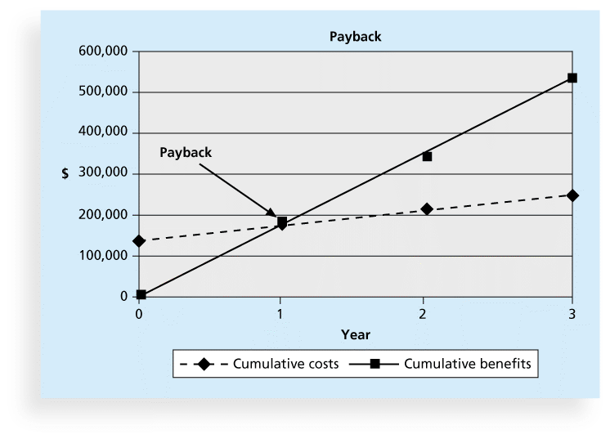
Calculations
ROI (Return on investment)
=(total discounted benefits – total discounted costs)/ total discounted costs
= (516, 000 – 243, 200)/ 243, 200 X 100
= 112%
ROI is always in percentage, higher the better
Can be positive and negative.
Payback analysis
Plot a graph showing all the cumulative costs. Year on x axis and amount on y axis.
Plot a graph showing all the cumulative benefits. Year on x axis and amount on y axis.
Place where they cross each other is payback back period.

Slide 15
Calculations
Cumulative benefits
year 0 : -140,000
Year 1: -140,000 (year 0-cumulative benefit) + 148, 800 (year 1; discounted benefit – discounted cost) = 8800
Year 2: 8800 (Year 1 cumulative benefit) + 137, 600 (year 2; discounted benefit – discounted cost) = 146,400
Year 3: 146, 400 (Year 2 cumulative benefit) + 126,400 (year 3; discounted benefit – discounted cost) = 272, 800
At the end of third year $272, 800 would be earned (in current dollar value)

Slide 16

Project Initiation Process
Initiating a project includes recognizing and starting a new project or project phase
The main goal is to formally select and start off projects
Table 3-3 shows the project initiation knowledge areas, processes, and outputs

Slide 17
Project Charter
authorizes a project
ensures that necessary resources and management commitments
ensures understanding of roles and responsibilities for a project before it starts
formal agreement that ensures project stakeholders share a common understanding of why the project is being done, the timeframe, deliverables, boundaries, and responsibilities.
not be confused with the business case. The business case should already be completed, and the investment decision to proceed with a project should be taken before a project charter.
does not change through the project life cycle. It is created at the beginning of the effort, approved by key stakeholders, and signed before work starts on a project.

Slide 18
Project Charter
Project Objectives: spell out what the project is trying to achieve.
Identify the product and what the product will deliver for the organizations (savings/ revenue $$$, increase in customer numbers, reduction in customer issues etc.)
Project Scope: define the scope of a project to avoid scope creep.
Functional and non functional requirement (prevent scope creep)
Project Timeline: the timeline for the project.
Identify the key milestones
Roles and Responsibilities: clarify roles and responsibilities. This is critical!
e.g. vendors, project team members, business users and also management.
Success Criteria: triple constraint and stakeholder satisfaction
Project Approach:
Spell out the overall project approach i.e. what are main project tasks, how these tasks will be done & who will be involved etc.
Avoid using technical terms.

Slide 19
Project Charter
Change Control:
spell out the change management process
E.g. What process should be followed if the client/user feels that a new requirement must be included in the final product, when it was originally not in scope?
7. Issue Management:
Document the issue management process.
Change requests, there are tons of other issues that a project manager needs to manage.
e.g. good templates like an official issue log and project status reports. Contact Information
8. Record all team members’, vendors and business user names and contact information into a central project library. This is REALLY useful if you have a crisis and can’t seem to locate a key team member.

Slide 20
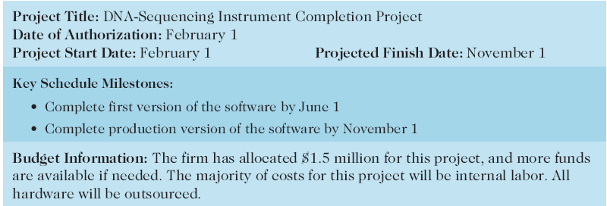
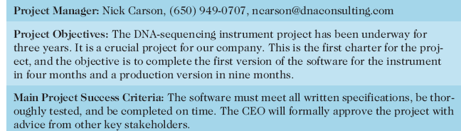
Table 4-1. Project Charter for the DNA-Sequencing Instrument Completion Project

Slide 21
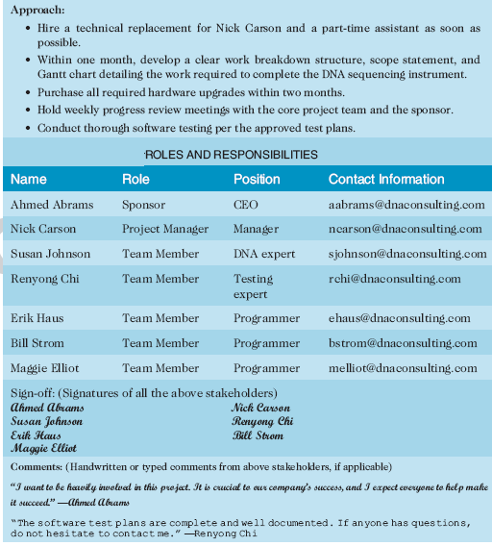

Slide 22
Stakeholder analysis
Advantages of Stakeholder Analysis 1. Get to know stakeholders better 2. Relative importance, power and interests 3. Better managed relationships 4. Risks identified 5. Make better strategies and decisions 6. Greater acceptance of organisation actions by stakeholders
Disadvantages of Stakeholder Analysis 1. Best done on continuous basis 2. Assessment of analysis may be subjective 3. Maybe not all stakeholder interests can be met at the same time 4. Focus is on most important stakeholder 5. Balance & reconcile all interests according to importance or urgency

Slide 23
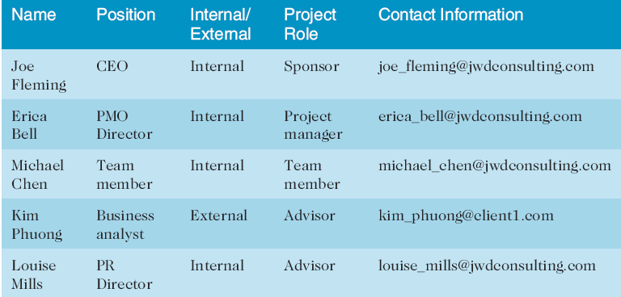
Table 3-4. Stakeholder Register

Slide 24
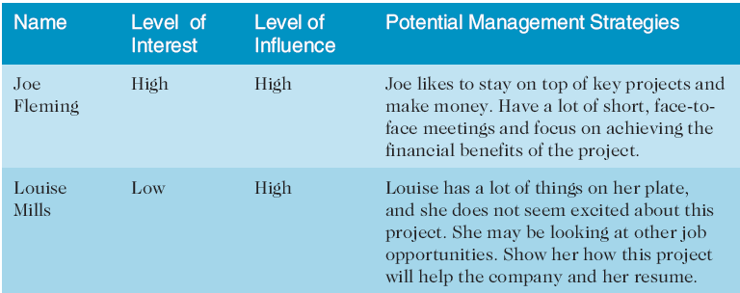
Table 3-4. Stakeholder Management Strategy
Contents are often sensitive, so do not publish this document.

Slide 25
Project Kick-off Meetings
Charters are normally short and include key project information and stakeholder signatures
It’s good practice to hold a kick-off meeting at the beginning of a project so that stakeholders can meet each other, review the goals of the project, and discuss future plans

Slide 26
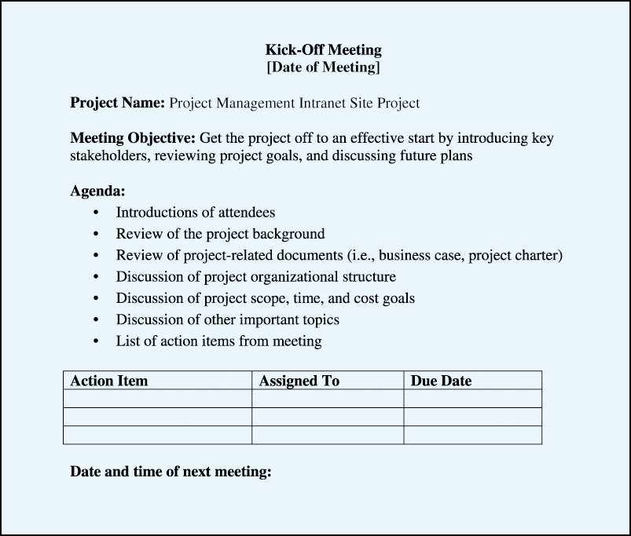
Figure 3-2. Kick-off Meeting Agenda

Slide 27
Planning Process- project plan/ proposal
The main purpose of project planning is to guide execution
Every knowledge area includes planning information (see Table 3-7 on pages 101-102)
Key outputs included include:
A team contract
Requirements document
Requirements matrix
Milestone report
A project scope statement
A work breakdown structure (WBS)
Stakeholder register
Risk register
Issue log
Requirements matrix
A project schedule, in the form of a Gantt chart with all dependencies and resources entered
A list of prioritized risks (part of a risk register)
Communication plan
Stakeholder management plan
Change management plan
Performance report
Budget plan
Quality plan
See sample documents starting on p. 104

Slide 28
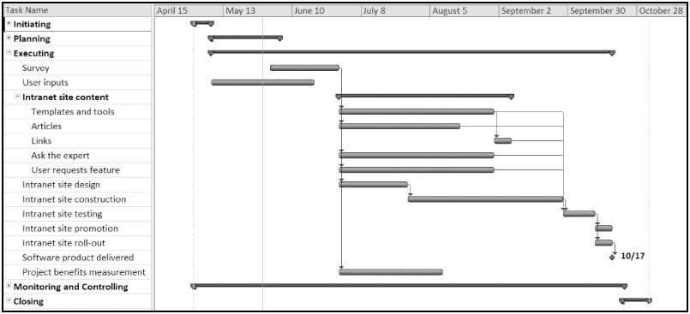
Figure 3-4. JWD Consulting Intranet Site Project Baseline Gantt Chart

Slide 29
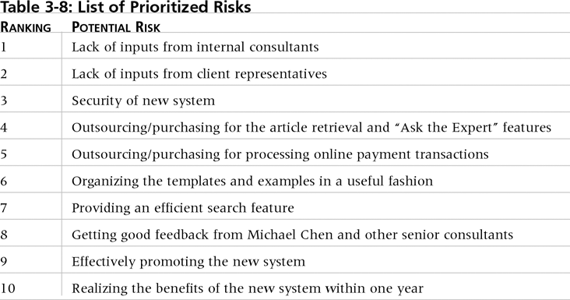
Table. 3-10. List of Prioritized Risks

Slide 30
Project Executing Process
Usually takes the most time and resources to perform project execution
Project managers must use their leadership skills to handle the many challenges that occur during project execution
Table 3-11 on p. 111 lists the executing processes and outputs. Many project sponsors and customers focus on deliverables related to providing the products, services, or results desired from the project
A milestone report (example on pp. 112-113) can help focus on completing major milestones

Slide 31
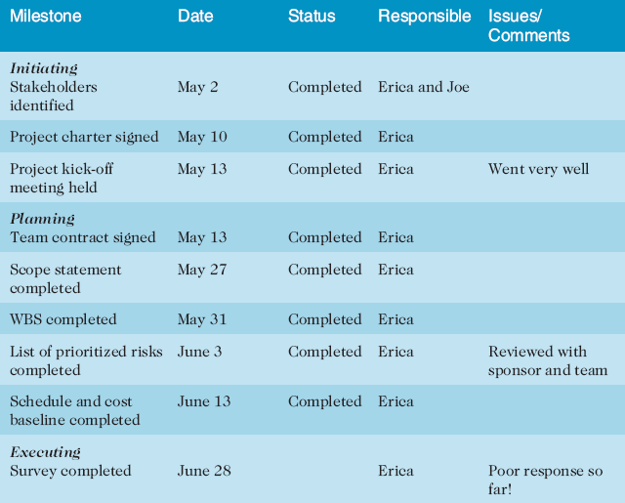
Part of Milestone Report (Table 3-11, partial)

Slide 32
Project Monitoring and Controlling Process
Involves measuring progress toward project objectives, monitoring deviation from the plan, and taking correction actions
Affects all other process groups and occurs during all phases of the project life cycle
Outputs include performance reports, change requests, and updates to various plans
See Table 3-13

Slide 33
Project Closing
Involves gaining stakeholder and customer acceptance of the final products and services
Even if projects are not completed, they should be closed out to learn from the past
Outputs include project files and lessons-learned reports, part of organizational process assets
Most projects also include a final report and presentation to the sponsor/senior management

Slide 34
Templates
Available on AUT online with assignment 1

Slide 35
Chapter Summary
The five project management process groups are initiating, planning, executing, monitoring and controlling, and closing
You can map the main activities of each process group to the nine knowledge areas
Some organizations develop their own information technology project management methodologies

